Slide 1
Programming Your Android App
Gourav Khadge
gkhadge@g.hmc.edu

Slide 2
The Android Language
Android is a Google App development language
Android is a variant of Java
Android is to Java as Arduino is to C
Adds several built in functions that are called during the lifecycle of the app
Adds the Activity/Intent structure

Slide 3
Your Android IDE
Android SDK
Eclipse based IDE
Android Studio
Google released their own IDE
Just use Android SDK
Download it here: http://developer.android.com/sdk/index.html?utm_source=weibolife

Slide 4
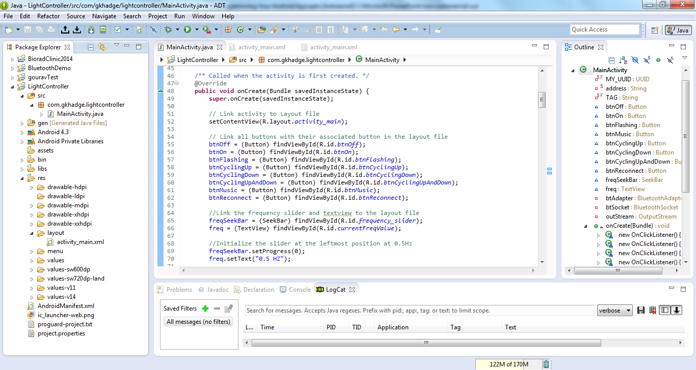

Slide 5
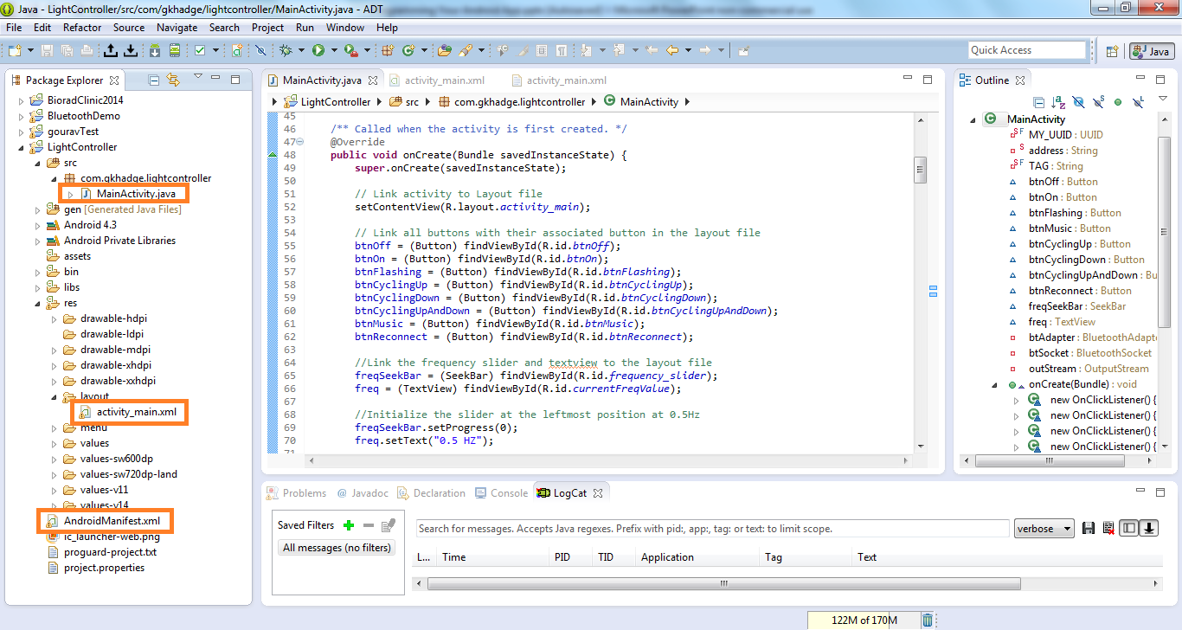

Slide 6
The Android Manifest XML File
Tells your app:
What permissions your app has
Bluetooth
Camera
What activities are in your app
App version data
App requirements
Specifies the App icon

Slide 7
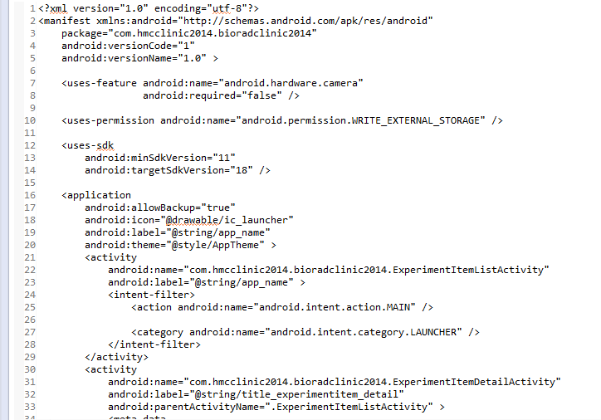
This app is version 1.0. It uses the camera, and has permission to write to external storage

Slide 8
The Layout XML Files
Each activity usually has an associated layout
Layout specifies the GUI
What buttons are on the page
Where they are placed
Linear layout and relative layout are different ways of specifying positions
The layout is where you specify an id for each UI element so it can be referred to in the class file
http://developer.android.com/guide/topics/ui/declaring-layout.html

Slide 9
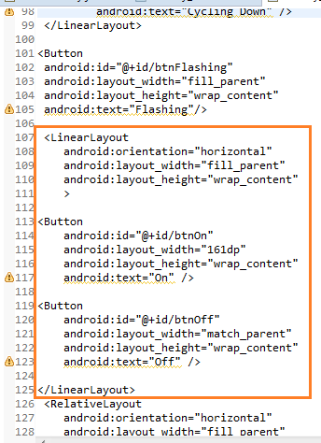
Tip: Use the text editor to edit your layout file
In this layout file, a horizontal linear layout is embedded in the structure
It has 2 buttons
The first one (left one) will be labeled “On” and have the id “btnOn” The second one (right one) will be labeled “Off” and have the id “btnOff”

Slide 10
The Activity Class Files
Every page is an “activity”
The activity is defined by a .java class file that:
Specifies a layout
setContentView(R.layout.activity_main);
Implements UI elements from layout file
Button btnOn = (Button) findViewById(R.id.btnOn);
Attaches layout elements to objects
Adds listeners (onClick, onTouch…)
Has several built in functions that are called during the lifetime of the activity

Slide 11
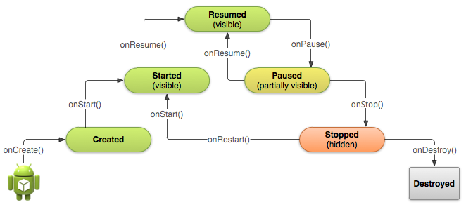
Life Cycle of an Android Activity
http://developer.android.com/training/basics/activity-lifecycle/starting.html

Slide 12
Intents
An intent object specifies what intent you have when you create a new activity.
This includes opening a new page as well as taking a picture
detailIntent = new Intent(this,ImportImage.class); startActivity(detailIntent);
Creates intent to open ImportImage page
Closes the current activity and starts the ImportImage activity
Intent takePictureIntent = new Intent(MediaStore.ACTION_IMAGE_CAPTURE); startActivityForResult(takePictureIntent, REQUEST_IMAGE_CAPTURE);
Creates intent to take an image using your native camera app
Launches the native camera app and waits for it to return with a result
http://developer.android.com/guide/components/intents-filters.html

Slide 13
Testing Your App
Android virtual devices
http://developer.android.com/tools/devices/managing-avds.html
An Android device
The preferred option if possible since virtual devices are slow and terrible
Requires USB to mini-USB cable and an Android device

Slide 14
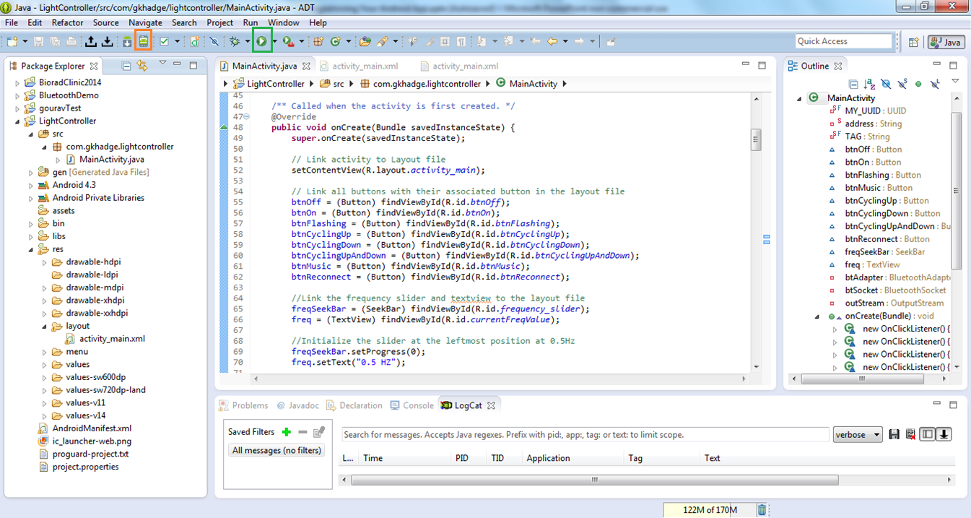

Slide 15
Helpful links
http://english.cxem.net/arduino/arduino5.php This shows you how to connect and transfer information through bluetooth. It doesn't show the layout file though. http://blog.idleworx.com/2011/06/build-simple-android-app-2-button.html You can see an example of a 2 button app with the layout file
http://developer.android.com Anything from this website. It also contains good documentation for all Android functions and libraries

Slide 16
Questions?

